Slide 1

Application: Dine Dash Type: Application Architecture View: Logical View Style: Layered Architecture Pattern
Users
Delivery Channels
Core Business Processes
Data And Information
Technology Enablers
Search Restaurants
Payment Gateways
Customers
Filtering Restaurants
User Profiles
Order Management Platform
Web Application
Browsing Menu
Order History
Restaurant Employees
Notification
Order Processing & Management
Restaurants Details
Payment
Geolocation API
Payment Details
Delivery Partner
Food Pickup
Cloud Services (AWS )
API Integration
Delivery Details
Delivery Tracking
Github & Delivery Pipeline
Feedback
Customer and Partner Feedback
Web Service Requesters

Slide 2
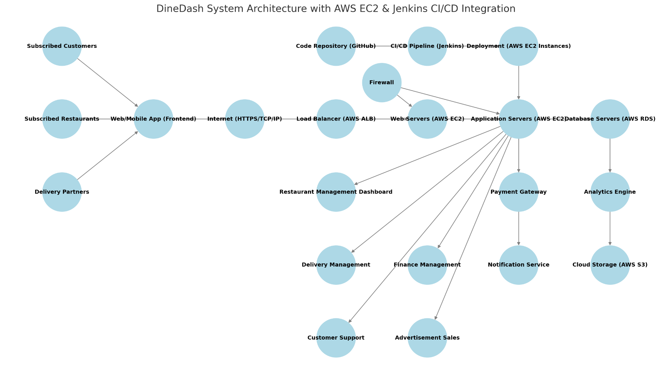
Type: Application Architecture
View: Process View
Style: Layered Architecture Pattern

